Slide 1
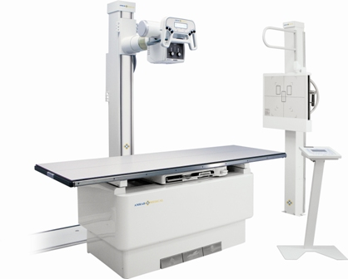
Maintain an X-ray machine
X-ray machine
principles of operation
function / use / scientific principles
construction
components / system diagram
inputs/outputs
troubleshooting
identifying common faults / replacing components / rectifying faults
preventive maintenance theory
replacing components/ calibrating
safety considerations
user and patient safety/ electrical safety
performance monitoring
calibration / quality assurance and control
18.6.3 Maintain an X-ray machine.
Unit C18.6 Maintaining Medical Imaging Equipment
Module 279 19 C Medical Instrumentation II
©
dr. Chris R. Mol, BME, NORTEC, 2016

Slide 2
Function / use / scientific principles
Much of the function, use and scientific principles of X-ray systems have been explained in the two previous lectures.
In this lecture, we cover construction and maintenance of Radiology systems that make static images.
This lecture does not have the ambition to enable you to fully maintain and X-ray system by yourself. Instead, you will be able to act as a receiver of customer complaints, solve some of the most common and simple problems, and interact as an interface with an X-ray service specialist. This means you need to speak his/her (X–ray) language !
In a next lecture we will cover the X-ray Fluoroscopy systems that make dynamic images (video).
©
X-Ray Machine
dr. Chris R. Mol, BME, NORTEC, 2016

Slide 3
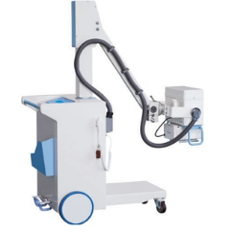
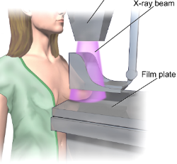
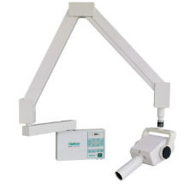
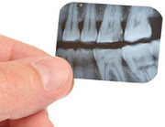
Various types / uses of X-ray systems
standard X-ray system with a table for full body exams and separate stand for Chest X-rays.
mobile X-ray system to go to patients. A detector plate is positioned in bed, under the patient.
mammography system for cancer detection.
dental X-ray tube. A small piece of film is put behind the teeth into the mouth of the patient.
©
X-Ray Machine
dr. Chris R. Mol, BME, NORTEC, 2016

Slide 4
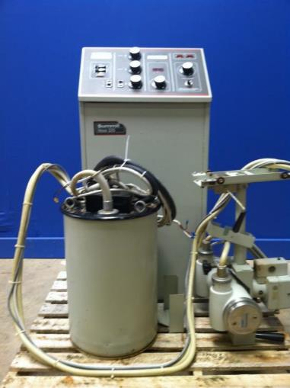
Construction
A Radiography system consists of:
X-ray tube
High Voltage Generator
X-ray Collimator
High Voltage Cables
Stand or Rail assembly
X-ray Detector
Control Desk
Control desk
High voltage
Cables
The next slides discuss these components in some more detail.
Tube, Collimator, and rail assembly
High Voltage
Transformer
©
X-Ray Machine
dr. Chris R. Mol, BME, NORTEC, 2016

Slide 5
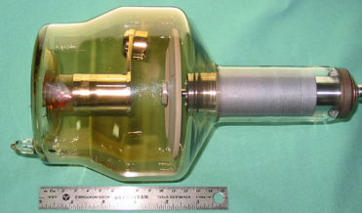
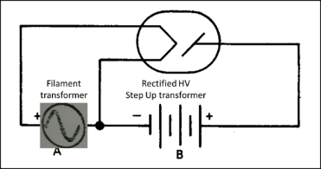
X-ray Tubes
Different types of tubes exist for different clinical uses and systems:
different anode construction, focal spot size, maximum heat capacities, tube housing style, insert materials.
Dental tubes often have a stationary anode. Radiographic tubes normally have a rotating anode. A rotating anode is more complex but allows for great ‘heat loading’.
Rotor control
The rotation of the anode is controlled by the rotor controller. There are low speed controllers and high speed controllers. Low speed tubes are for general radiography and typically rotate about 3,000 rpm. High speed tubes are for special procedures like fluoroscopy and typically rotate at up to 10,000 rpm.
The rotor controller will inhibit exposures with an interlock circuit if the tube is not achieving adequate rotation.
The rotor control may be a generator function or in a separate electronic cabinet.
©
X-Ray Machine
dr. Chris R. Mol, BME, NORTEC, 2016

Slide 6
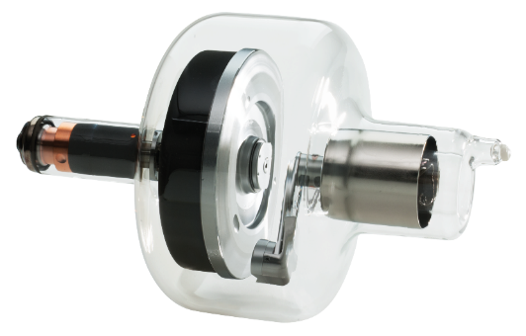
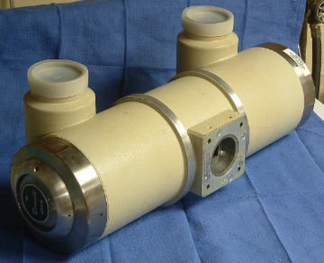
X-ray tube
High Voltage In
Anode disc rotation mechanism (‘rotor’)
X-ray Out
anode disk
kathode
X-ray Tube Container
protects the tube from mechanical shock and absorbs stray X-ray radiation
X-ray Tube ‘Insert’; the inside is vacuum
©
Radiology Fundamentals
dr. Chris R. Mol, BME, NORTEC, 2016

Slide 7
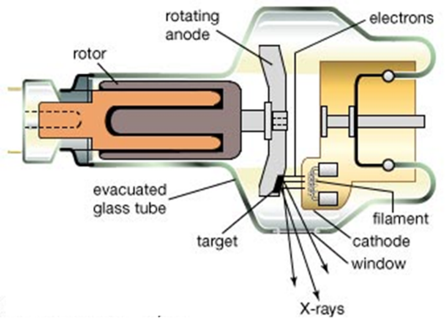
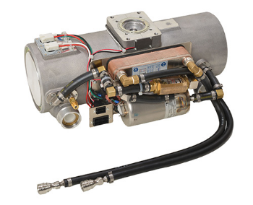
X-ray tube
In high-end X-ray tubes, the anode is rotating, so that it can absorb more heat. Temperatures of 3000ºC can be reached.
Also, the anode may be cooled with water or with oil, that is circulated through the tube and cooled with a ‘heat exchanger’ outside the tube.
The place on the anode where X-rays are generated is called the ‘focal spot’.
tubes with cooling fluid
©
Radiology Fundamentals
dr. Chris R. Mol, BME, NORTEC, 2016

Slide 8
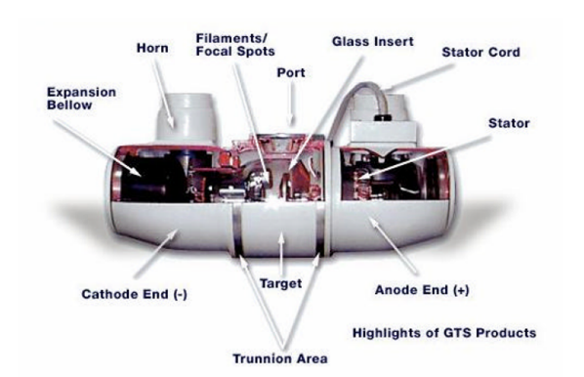
Troubleshooting X-ray Tubes
X-ray tubes wear out by their use and need to be replaced regularly. Depending on use this will be done every 2-4 years or longer.
Many tube components can break down, including rotor bearings, filament failure, anode track damage, …
Simple indications for a defect X-ray tube
Normally, you can hear the rotor spin up! If the machine has a rotating anode and you can’t hear it spin that is probably the reason the machine is prevented from generating X-rays.
In a dimly lit room, you can see the X-ray tube make an intensifying screen glow! Is the housing red hot?
There are no field serviceable parts inside the tube ‘assembly’ (tube and housing). Do not disassemble a tube housing: it has implosion hazard (vacuum!). Replacing X-ray tubes is not possible without expensive and specialized test equipment plus knowledge of working with high voltages and radiological re-calibration.
©
X-Ray Machine
dr. Chris R. Mol, BME, NORTEC, 2016

Slide 9
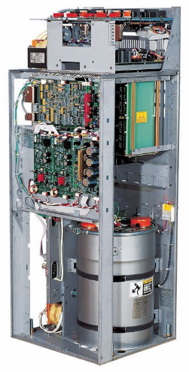
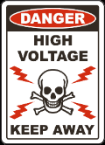
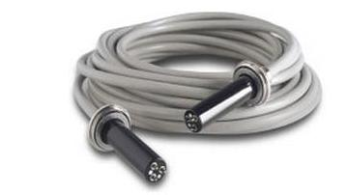
X-ray High Voltage (HV) generator
The X-ray HV generator creates the high voltage required to accelerate the electrons travelling to the anode. The high voltage used is in the order of 80 kV = 80,000 Volts.
The X-ray HV generator also creates the (low voltage) electric current that is used to heat up the filament of the X-ray tube.
A special High Voltage cable is used to connect the X-ray generator and the X-ray tube.
X-ray HV Generator
©
Radiology Fundamentals
dr. Chris R. Mol, BME, NORTEC, 2016

Slide 10
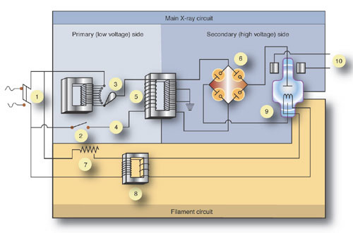
Schematic diagram of a simple X-ray Generator
1- main breaker
2- exposure switch
3- autotransformer
4- timer circuit
5- high voltage transformer
6- Rectifier Bridge
7- Filament control
8- Filament step down
9- X-ray Tube
10- rotor stator.
©
X-Ray Machine
dr. Chris R. Mol, BME, NORTEC, 2016

Slide 11
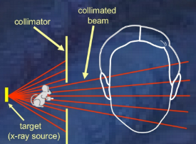
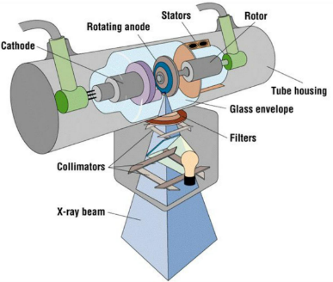
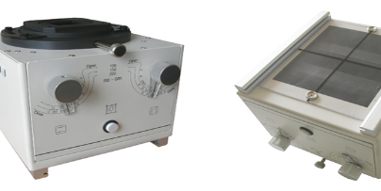
X-ray collimator
The primary function of the collimator is to reduce the size of the radiation field to the area of interest.
This also reduces scatter and helps with image quality.
The collimator is also where the beam filtration is installed. Beam filtration consists of plates of mostly Copper or Aluminum where the X-ray beam passes through. Such filters absorb useless, low energy radiation (‘Bremsstrahlung’).
Collimator principle
Collimator fixed to X-ray tube
Collimator
©
Radiology Fundamentals
dr. Chris R. Mol, BME, NORTEC, 2016

Slide 12
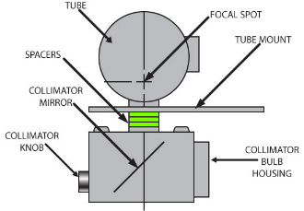
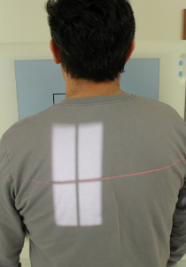
X-ray collimator
The collimator setting needs to be adapted to the size and position of the image detector: no X-ray radiation should be sent out to where it is not detected.
A lamp in the collimator projects light on the patient to indicate where the X-ray beam will be.
The most common collimator failure is a non-functioning lamp.
Try to get and keep an extra bulb.
Don’t touch it will your fingers during installation. Oil on your fingers creates a hot spot on the bulb.
©
Radiology Fundamentals
dr. Chris R. Mol, BME, NORTEC, 2016

Slide 13
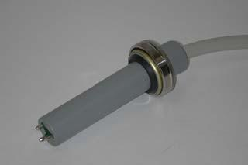
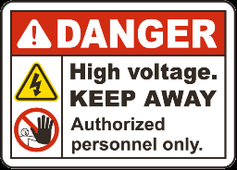
High Voltage Cable
High Voltage Connector
Can arc destructively just from sweat on human fingers!
Can hold a large capacitive charge after the machine has been ‘turned off’. Grounding procedures must be used to render the high voltage section safe.
Can not be measured with ‘normal’ voltage measurement instruments.
Standard High Voltage Connector
©
X-Ray Machine
dr. Chris R. Mol, BME, NORTEC, 2016

Slide 14
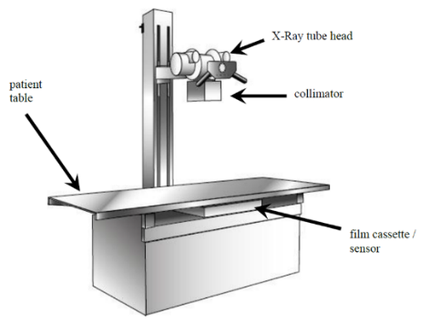
Stand and Rail assembly
As shown earlier, there are many different mechanical constructions to support Patients, X-ray tubes and detectors.
As always, anything that is mechanical and moves will need good maintenance (clean, grease). It will still be susceptible to problems. Mechanical parts loosen and jam. This is frequently the cause of problems in X-ray systems.
There may be a check (sensor) on the presence of the X-ray cassette (with film) in the table location. If the detector is not present, this will prevent the system from generating X-ray.
©
Radiology Fundamentals
dr. Chris R. Mol, BME, NORTEC, 2016

Slide 15
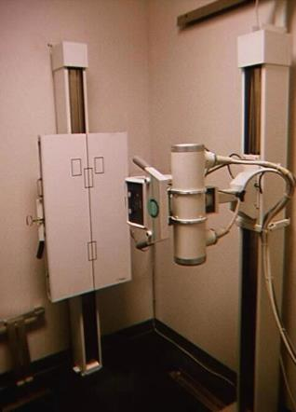
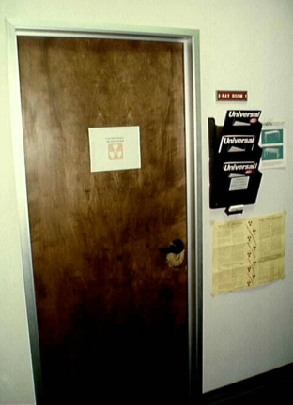
X-ray rooms
Walls and door of an X-ray room are shielded with lead to protect the staff as well as patient in adjacent rooms.
The X-ray tube and the detector are moved up or down to match the height of the patient
The door to the X-ray room contains lead. It must be closed during exposures.
Some machines will be connected to a door switch and will not make an exposure if the door is open or the switch is broken.
cable drape:
things get stuck here !
©
X-Ray Machine
dr. Chris R. Mol, BME, NORTEC, 2016

Slide 16
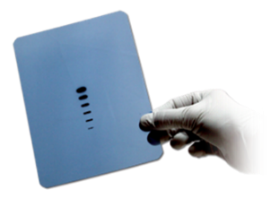
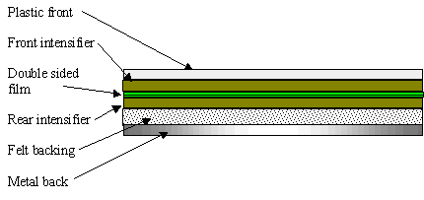
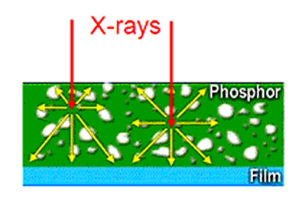
X-ray detection
‘Photographic’ film is insensitive to X-ray: 98% of X-rays would travel through without interaction.
That’s why an ‘intensifying screen’, made of fluorescent material, is mounted in front of the film. It converts the X-ray photons into visible light photons. The amount of light that it produces is proportional to the amount of incoming X-rays. The light photons are recorded by the photographic film.
Photographic film
Intensifying screen
©
Radiology Fundamentals
dr. Chris R. Mol, BME, NORTEC, 2016

Slide 17
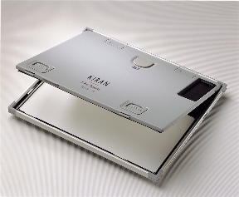
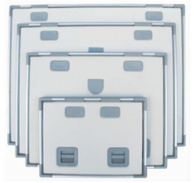
Film based, ‘conventional’ X-ray detection
Cassettes are light-proof, rigid containers that enclose the X-ray film to protect it from light. Within the cassette are two intensifying screens that fluoresce and produce visible light when irradiated by X-rays. The film is placed between the two intensifying screens, inside the cassette.
The cassettes must be strong, rigid and durable. They must provide firm pressure so that there is good contact between the film and the screens, but must be easy to open in the dark.
Cassettes come in different sizes
©
Radiology Fundamentals
dr. Chris R. Mol, BME, NORTEC, 2016

Slide 18
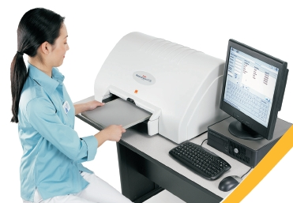
‘Digital’ X-ray systems: CR
Since the 1980’s different generations of digital X-ray technology have entered the market place:
CR Reader
Computed Radiography (CR):
Computed radiography uses PSP (Photo Stimulated Storage Phosphor) technology in cassettes, combined with a plate reader. X-ray is recorded/stored on the CR plate and then put in a Reader to read out the image information.
This requires the same operator actions as a screen/film system but eliminates dark room processing. The data on the CR cassettes can be erased so that the cassette can be re-used.
CR cassette
Computer
CR cassettes with different sizes
CR system can have damage to the cassettes, causing artifacts.
The reader can have problems, usually mechanical.
©
Radiology Fundamentals
dr. Chris R. Mol, BME, NORTEC, 2016

Slide 19
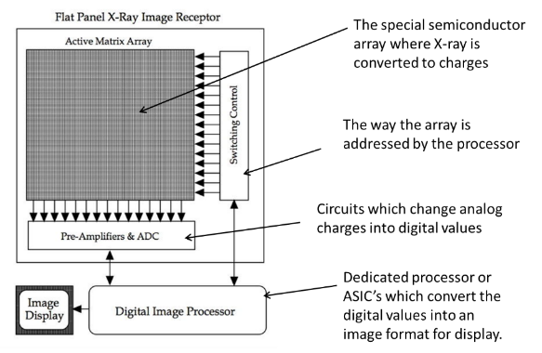
‘Digital’ X-ray systems: DR
Digital Radiography (DR):
Digital Radiography (DR) uses direct digital read out from the detector into a digital signal. With this method, there is no need for a separate ‘reader’. There are several technologies used - and under development - for this. Most use the same semi-conductor technology that is used to produce Integrated Circuits (IC’s).
DR detector, with cable (!)
If Digital Detectors capture a good image they work, otherwise you replace them. You can’t fix them, but they are quite robust.
©
Radiology Fundamentals
dr. Chris R. Mol, BME, NORTEC, 2016

Slide 20
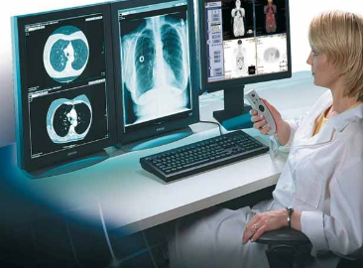
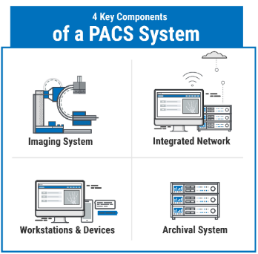
‘Digital’ X-ray systems
The main value of the various detectors in digital radiography is not so much their improved image quality, but the ability to communicate, process and archive X-ray images with computers. Such hospital computer systems are known as PACS systems: Picture Archiving and Communication Systems. These are now common in rich countries.
PACS ‘viewing’ or ‘work’ station
Computer programs are used to call up different images, process these for improved visibility, write/dictate reports with findings, annotate images, send out the reports and archive all data for instantaneous availability throughout the hospital. All this has considerably changed the workflow in radiology departments as well as in the hospital.
©
Radiology Fundamentals
dr. Chris R. Mol, BME, NORTEC, 2016

Slide 21
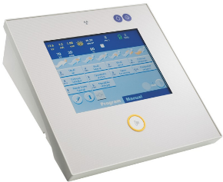
X-ray Control Unit
In simple X-ray systems, the voltage, filament current and X-ray pulse width are entered manually on a ‘generator desk’. Together, these parameters determine for a large part the resulting Image Quality.
In more modern and complex system, X-ray exposure control is performed automatically by the X-ray system. This is one reason that X-ray systems require that the user inputs what body part is being imaged. It uses this information to set the X-ray parameters.
X-ray system
user interface
©
Radiology Fundamentals
dr. Chris R. Mol, BME, NORTEC, 2016

Slide 22
Troubleshooting
Common complaints of X-ray systems consist of:
getting no exposure / image
getting poor quality images
mechanical failure of table/rail movement, knobs, buttons, equipment handles, motor drives, etc.
Common causes are:
user error, such as wrong program (‘technique’) selection, no cassette placed, …
High Voltage transformer failure
X-ray control failure
collimator failure
Stand failure
…..
‘No Exposure’ is often related to the Generator control. This unit contains a lot of safety circuits and interlocks that prohibit the generation of X-ray when something is deemed to be wrong. This may be caused by user error.
Cable problems are common: cable drapes get caught. Power cables are stretched and broken. Cables are constantly flexed and will fail at strain reliefs. Cables running to the tube support are very susceptible due to the constant movement.
©
X-Ray Machine
dr. Chris R. Mol, BME, NORTEC, 2016

Slide 23
Troubleshooting
When trouble shooting an X-ray system, it is not practically possible to start with a book of schematics. X-ray systems are too complex for that.
First, you need to ‘narrow down’ the problem – based on your understanding of the system - to a specific sub-system. Then you need the service documentation to find the faulty component.
Actual mechanical and electronic designs vary a a lot between different manufacturers. However, the sub-system functions are similar.
Rules for troubleshooting:
Know your machines intimately.
Keep records!
Gather all the information available about the fault.
Reproduce the actual failure
Isolate from system knowledge the sub-system you suspect.
Troubleshoot to the component level. Verify that the suspected component is bad.
Check the new component functions correctly.
Test the system and compare with the documentation on file.
©
X-Ray Machine
dr. Chris R. Mol, BME, NORTEC, 2016

Slide 24
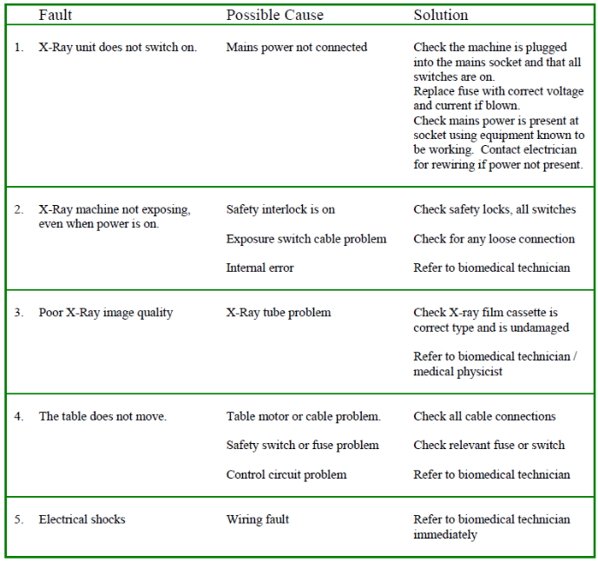
Troubleshooting
©
X-Ray Machine
dr. Chris R. Mol, BME, NORTEC, 2016

Slide 25
Preventive Maintenance
An X-ray Room PM occurs at least once (or twice) a year. A full X-ray room PM will take several hours to two days to complete.
Get the preventive maintenance instructions from the service manual. It should include activities on all the main system components as well as on Automatic Exposure Control and on Image Quality.
Some Highlights:
vacuum dust and dirt out of equipment
check all wiring and connections
check all mechanical (table, tube stand) movements
check alignment of tube to receptors
check all lamps and indicators
check if various modes of operation are functional
check level of oil in transformer
lubricate moving mechanical parts
apply touch up paint to equipment scratches
check Image Quality
clean the floor and every equipment surface
High Voltage work requires more training and special tools!
©
X-Ray Machine
dr. Chris R. Mol, BME, NORTEC, 2016

Slide 26
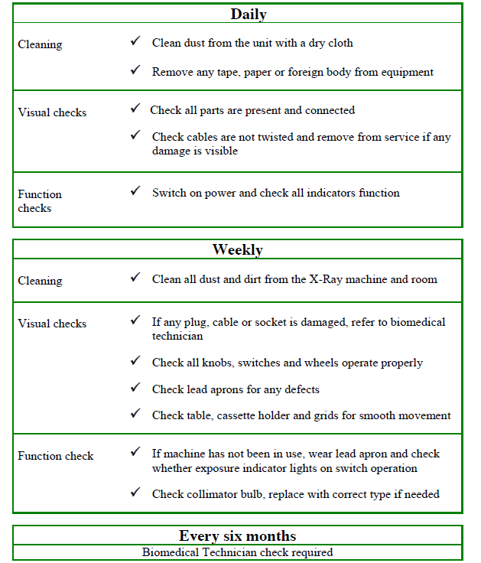
Preventive Maintenance User Care
©
X-Ray Machine
dr. Chris R. Mol, BME, NORTEC, 2016

Slide 27
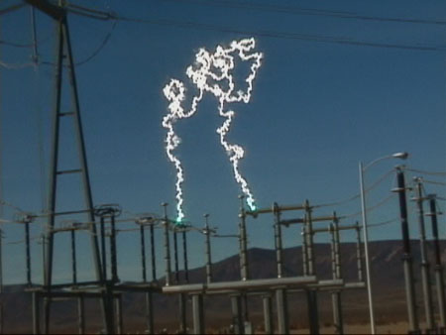
Safety considerations
Electrical Hazards
You do not need to touch high voltage to be killed! It can reach out and touch you!
Electrical Hazards
http://www.youtube.com/watch?v=WNot2owIv8c&feature=related
Radiation Hazards
http://www.youtube.com/watch?v=hsmzxc1AGZM
Time, Distance, & Shielding
Biohazards
http://www.youtube.com/watch?v=O-lD-N3JTVc
On your USB stick
©
X-Ray Machine
dr. Chris R. Mol, BME, NORTEC, 2016

Slide 28
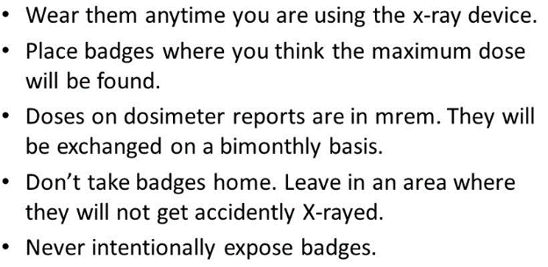
Safety considerations
To avoid health problems from daily exposure, wear protective equipment; operate behind shielding,
increase your distance, and decrease your exposure time.
X-ray protective lead glass spectacles
Mobile Shield
Lead Apron
Personal Dosimeter
©
X-Ray Machine
dr. Chris R. Mol, BME, NORTEC, 2016

Slide 29
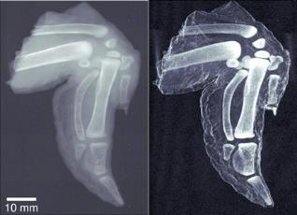
Performance monitoring: Image Quality
Next to the normal functions of an X-ray system it is important to monitor the Quality of the images that the system produces. Many technical problems and wear and tear of these systems lead to a reduced Image Quality.
Image Quality is critical for making the best possible diagnosis from the images. This is about saving lives!
Terminology
Optical Density is the overall ‘blackening’ of the film. The image must be dark enough so anatomy can be clearly seen on a display.
Densitometer: a device to measure optical density
A high quality image has good optical density, sufficient contrast, good resolution, low noise and low ‘distortion’.
Low contrast
High contrast
In order to judge whether image quality is good, you need to be familiar with the pictures the system makes when working normally.
©
X-Ray Machine
dr. Chris R. Mol, BME, NORTEC, 2016

Slide 30
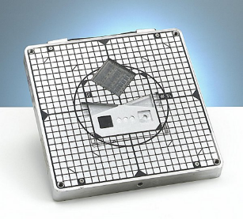
Performance monitoring: Image Quality
Factors that influence Image Quality:
X-ray generator (Technique Selection)
X-ray tube
the collimator
the distance between tube and patient
The Patient
The Radiographic Table
The Image Receptor
X-ray Film
Film Processing
Viewing the Image
An X-ray phantom is very useful for recording system performance and later making comparisons to diagnose image quality problems.
The most common image quality problems are:
Processor (dirty chemicals, temperature)
Technique setting (KVp, mA, time)
Patient Motion
Film & Cassette
©
X-Ray Machine
dr. Chris R. Mol, BME, NORTEC, 2016

Slide 31
END
The creation of this presentation was supported by a grant from THET:
see https://www.thet.org/

